Slide 1

DRIVER DROWSINESS DETECTION
Number :
Che Minh Quang (Leader)
Nguyen Trong Nghia
Bui Dinh Thanh Danh
Pham Gia Thinh
11 November 2023

Slide 2

1
1
INTRODUCTION PROJECT
2
TIMELINE & TASKS
3
COLLECT AND PROCESS DATA
CONTENT
4
MODEL
5
DEMONSTRATION
6
CONCLUSION
7
FUTURE OF PROJECT
© Copyright FPT Software – Level of Confidentiality

Slide 3
01. INTRODUCTION PROJECT

Slide 4
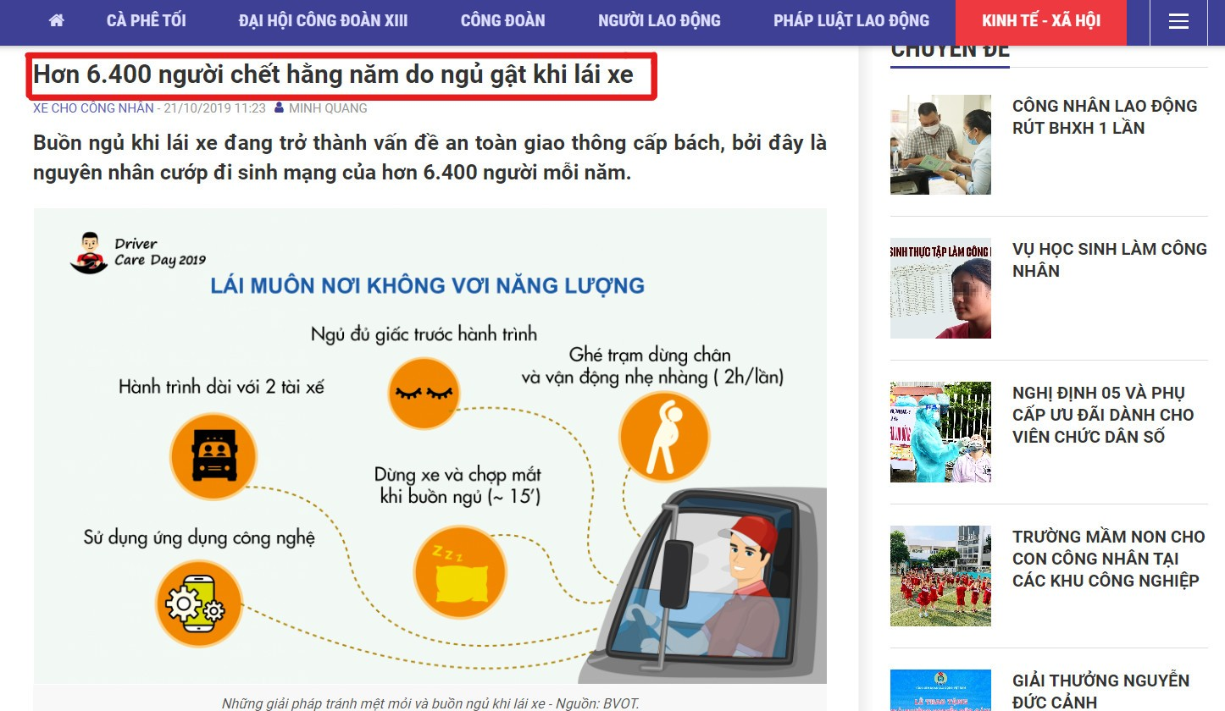
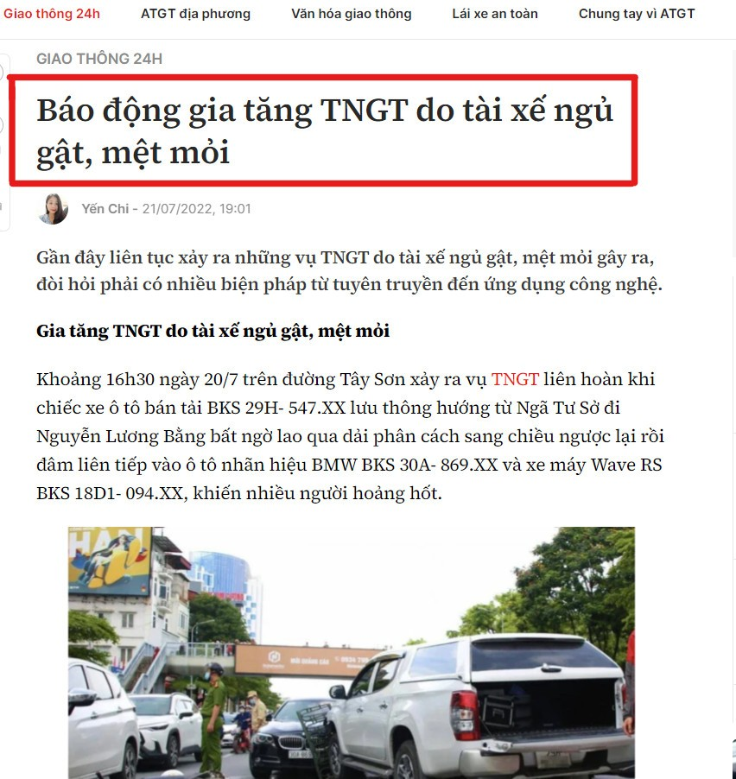
01. INTRODUCTION PROJECT
Ideas for projects

Slide 5
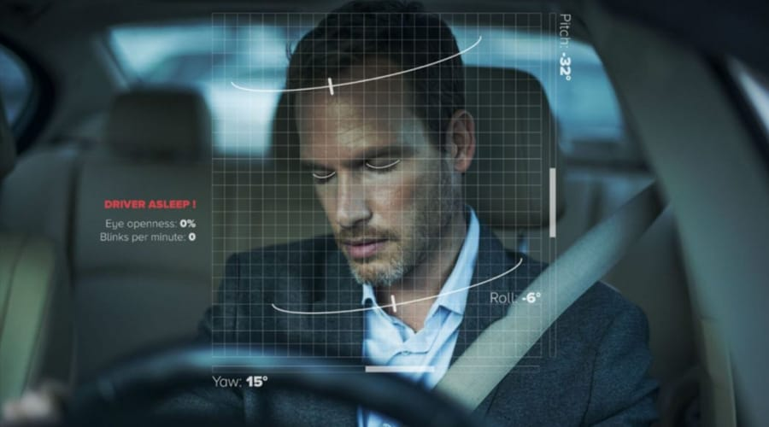
01. INTRODUCTION PROJECT
Ideas for projects
The main causes of drivers falling asleep while driving:
Drivers have to work continuously for many hours.
Driver works at night.
Caused by health factors.
Work pressure.
Our team decided to build a project on driver drowsiness detection.

Slide 6
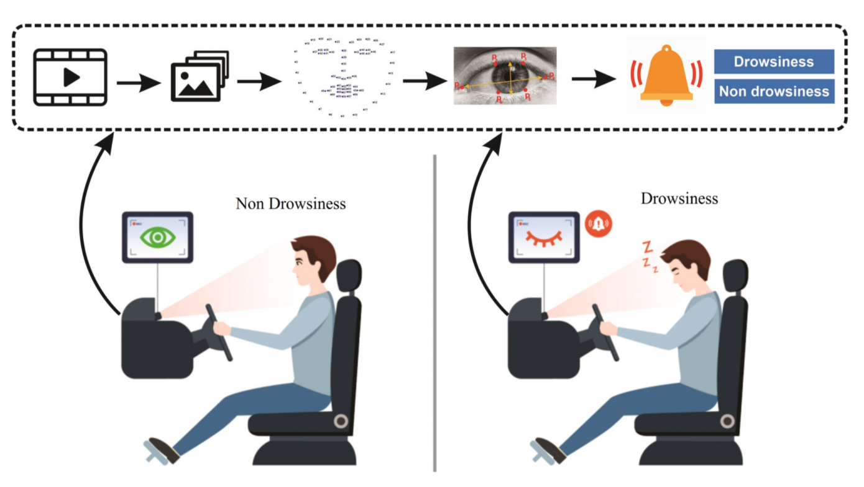
01. INTRODUCTION PROJECT
Description of the problem
The goal of the project is to build a system that will detect that a person's eyes are closed for a few seconds. This system will warn the driver when it detects drowsiness.
The approach we will use for this Python project is as follows:
Get images from the camera from the Web to the Backend
Pass the image through the processing model.
Return the status of the eye to the web.
Give a warning.

Slide 7
02. TIMELINE & TASKS

Slide 8
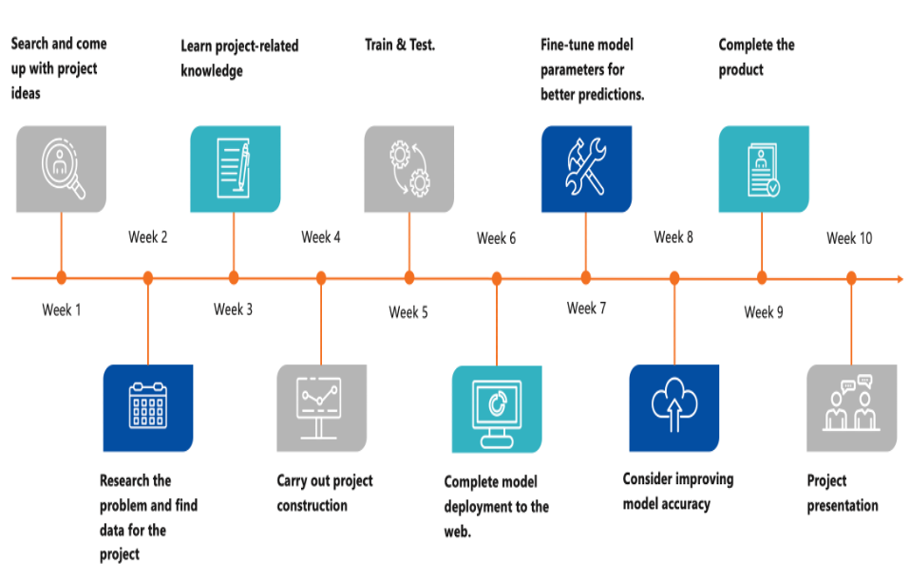
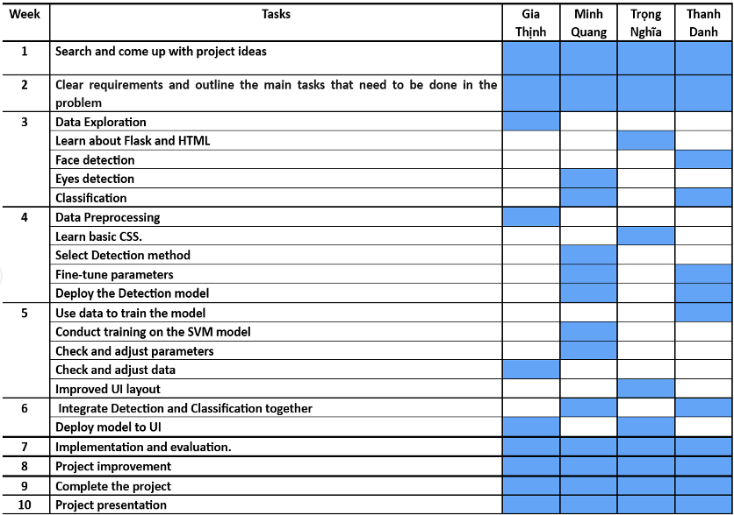
02. TIMELINE & TASKS

Slide 9
03. COLLECT AND PROCESS DATA

Slide 10
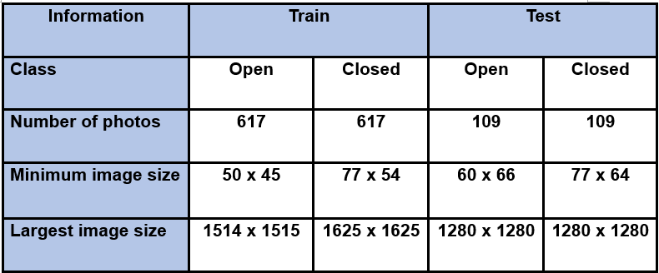
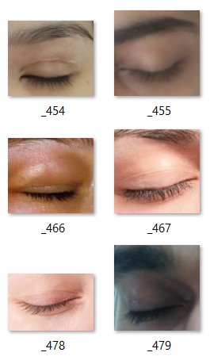
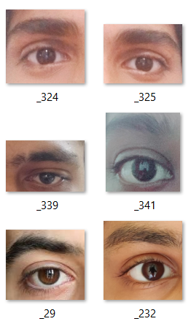
03. COLLECT AND PROCESS DATA
Collect data
The data is collected from the dataset named "yawn_eye_dataset_new" from the Kaggle website, at the link "https://www.kaggle.com/datasets/serenaraju/yawn-eye-dataset-new."

Slide 11
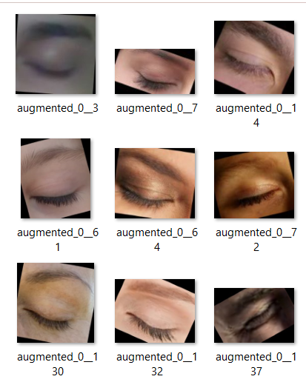
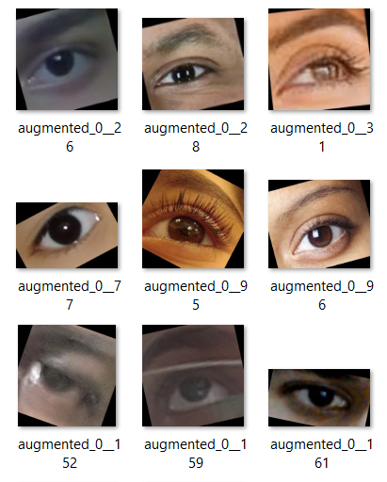
03. COLLECT AND PROCESS DATA
Process data
Use data augmentation techniques to increase the amount of data

Slide 12
04. MODEL

Slide 13
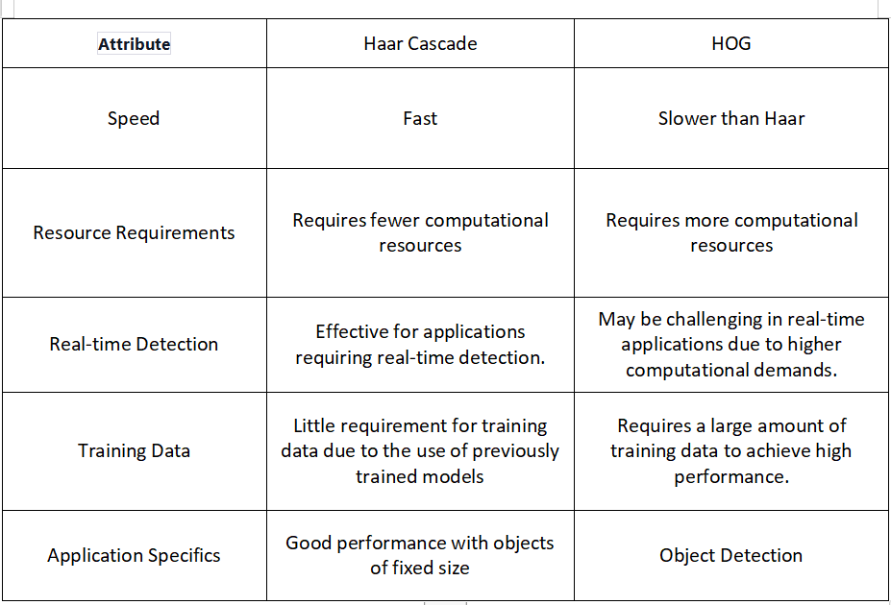
04. MODEL
Model divided into 2 main tasks:
Detection
Face Detection
Eyes Detection

Slide 14

04. MODEL
Classification: Open / Closed Using model Support Vector Machine (SVM)
Able to process data with many features (Open/close ratio, Eye position, Brightness and color,..)
Hyperparameters can be adjusted to achieve optimal performance
Generalization ability

Slide 15
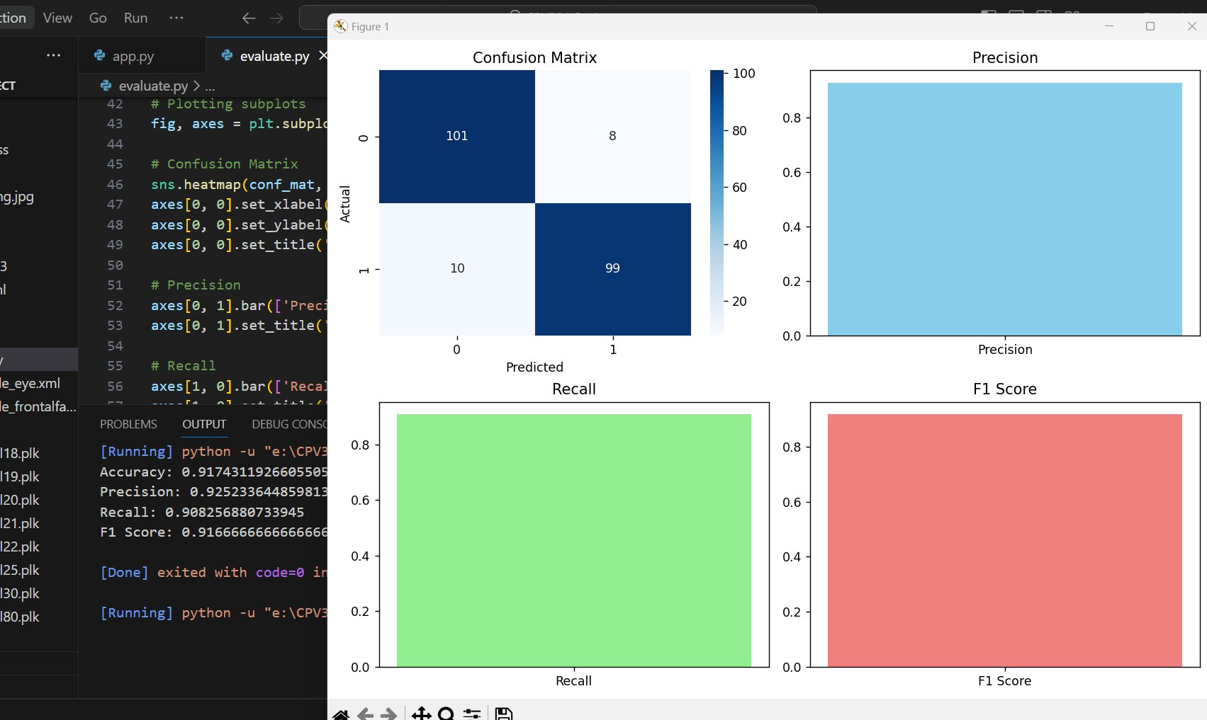
04. MODEL
Evaluate The goal of the model evaluation process is to evaluate the model's performance on test data or new data that the model has never seen.
Confusion Matrix
Accuracy
Precision
Recall
F1 Score

Slide 16
05. DEMONSTRATION

Slide 17
06. CONCLUSION

Slide 18
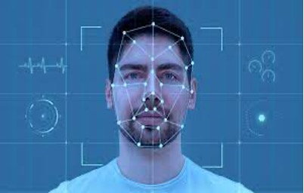
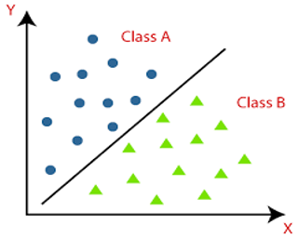

06. CONCLUSION
Learned knowledge:
Image Processing
Face detection
Eye detection
Classification
Flask and HTML
Missing something to perfect the product:
Lack of time because there are so many other subjects and projects to do.
Lack of knowledge about new languages and how to handle data in the most optimal way.

Slide 19
07. FUTURE OF THE PROJECT

Slide 20
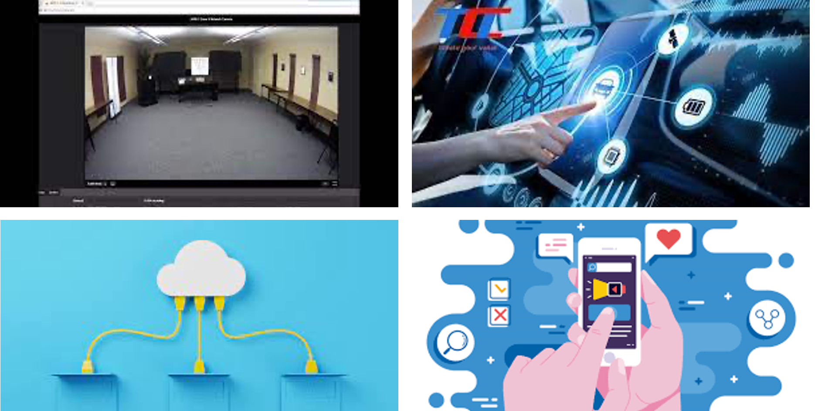
07. FUTURE OF THE PROJECT

Slide 21


